Slide 1

Smart Ambulance Dispatch and Route Optimization
Advanced DSA-Based Emergency Healthcare Resource Allocation System
DSA-III PROJECT
FINAL REVIEW
Team Members: [P Bhavya 2510030379
Sejal Heda 2510030350
B Siri 2510030325
T Hansika 2510030330
M Mounika 2510030343] | Faculty Guide: [Dr M.Saidireddy] | [CSE], [KL University]

Slide 2



Problem Statement and Objectives
The Challenge
Project Objectives
During emergencies, selecting the right ambulance, finding an efficient route, selecting a suitable hospital, and allocating limited beds and doctors becomes critical — especially when multiple emergencies occur simultaneously.
Prioritize Emergencies
Optimize Routes
Apply graph algorithms for fastest ambulance routing
Key Challenges
Use priority queues to handle critical cases first
Emergency prioritization based on severity
Ambulance selection and real-time availability
Route optimization for fastest response
Hospital resource allocation under constraints
Doctor-patient matching by specialization
Medical record search — exact and fuzzy
Handling multiple concurrent emergencies
Allocate Resources
Match Patients
Efficiently distribute hospital beds and staff
Connect patients with suitable doctors by specialization
Fast Record Retrieval
Support exact and fuzzy medical record search

Slide 3

Proposed Smart Ambulance System
Emergency Intake
Dispatch
Resource Allocation
Completion
Frontend
Backend
DSA Engine
Database
Admin Dashboard
Emergency Interface
Ambulance & Hospital Management
Python + FastAPI with REST APIs
Uvicorn Application Server
Priority Queue, Dijkstra, Dinic
Bipartite Matching, KMP, Edit Distance, Bitmask DP, TSP
SQLite — Admin, Hospital, Ambulance
Doctor, Patient, Emergency, Dispatch tables

Slide 4








Data Structures and Algorithms Implemented
All eight algorithms are fully implemented and integrated into the working backend.
Priority Queue
Graph + Dijkstra
Emergency prioritization by severity level
Shortest route calculation through road network
Dinic / Max Flow
Bipartite Matching
Hospital bed allocation optimization
Doctor-patient assignment by specialization
KMP Algorithm
Edit Distance
Exact medical record string search
Fuzzy medical record search and retrieval
Bitmask DP
TSP Approximation
Multi-stop route optimization
Large-scale route optimization at scale

Slide 5
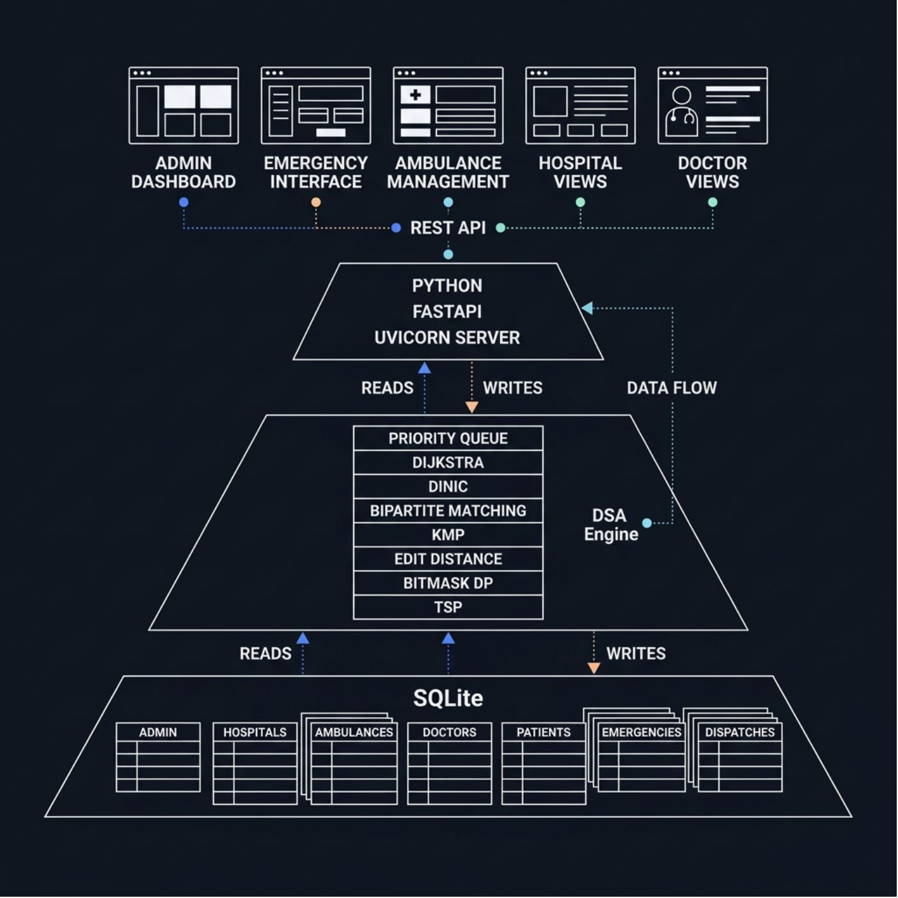
System Architecture and Technology Stack
Communication Flow
Frontend ↔ REST API ↔ FastAPI Backend ↔ DSA Engine ↔ SQLite Database
Frontend Layer
Admin Dashboard, Emergency Interface, Ambulance Management, Hospital & Doctor Views
Backend Layer
Python, FastAPI, REST APIs, Uvicorn Server
DSA Engine Layer
Priority Queue, Dijkstra, Dinic, Bipartite Matching, KMP, Edit Distance, Graph Algorithms, Dynamic Programming
Database Layer
SQLite — structured tables for Admin, Hospitals, Ambulances, Doctors, Patients, Emergencies, and Dispatches

Slide 6

Core DSA Implementation
Emergency Severity Levels
Algorithm Applications in Practice
Priority Queue ensures the highest-severity emergency is always handled first for immediate dispatch.
Priority Queue
Highest-priority emergency handled first — immediate dispatch
Dijkstra
Shortest path through road network graph — fastest ambulance routing
Dinic / Max Flow
Allocates patients to hospitals respecting bed capacity constraints
Bipartite Matching
Matches patients with doctors by specialization and availability
KMP + Edit Distance
Exact and fuzzy search on patient medical records for fast retrieval
🔴 Critical
🟠 High
🟡 Medium
🟢 Low
Priority = 10
Priority = 8
Priority = 5
Priority = 2

Slide 7


End-to-End Emergency Dispatch
Testing Coverage
1
API Connectivity
REST endpoint validation across all modules
Emergency Received
Hospital Allocated
2
Authentication
Severity assessed, queued by priority
Bed check via Dinic, doctor matched
Admin login, authorization, and session management
3
Ambulance & Hospital
Retrieval, availability, and resource queries
4
Dispatch Workflow
End-to-end emergency dispatch with DSA validation
Ambulance Dispatched
Dispatch Complete
5
Database Integrity
Dijkstra routing, nearest unit assigned
Final dispatch issued, DB updated
Operations, data consistency, and correctness checks
[Insert Screenshot — Final Emergency Dispatch Output]

Slide 8
Deployment, Impact and Future Scope
Deployment Status ✅
Future Scope 🔭
Localhost development environment
FastAPI backend with Uvicorn server
SQLite database integration
Frontend with REST API integration
Successfully tested and deployed
Real-Time GPS
Traffic Integration
Live ambulance tracking and location updates
Dynamic routing with live traffic data
System Impact 🚑
Mobile App
Notifications
Faster emergency prioritization and response
Improved ambulance utilization and efficiency
Optimized route selection reducing travel time
Efficient hospital resource allocation
Better doctor-patient matching by specialization
Support for multiple concurrent emergencies
Fast and accurate medical record search
Emergency reporting via mobile application
SMS and push notification system
Cloud Migration
AI Prediction
Scalable cloud database and infrastructure
AI-assisted emergency prediction and prevention

Slide 9





Conclusion
Smart Ambulance Dispatch and Route Optimization demonstrates how Data Structures and Algorithms can be integrated into a practical, real-world emergency healthcare application.
Emergency
Request received & severity assessed
Priority
Queue orders critical cases first
Ambulance
Nearest unit dispatched via Dijkstra
Hospital
Bed allocated, doctor matched
Dispatch
System updated, lifecycle complete
DSA Algorithms + FastAPI Backend + Frontend UI + SQLite Database + REST APIs = Smart Emergency Resource Allocation System
An intelligent, algorithm-driven approach to emergency healthcare resource allocation.
Thank You
Questions & Discussion

